Slide 1
IOT

Slide 2
Agenda
Introduction to IoT
Applications of IoT
Introduction to Arduino
Working with Various Sensors
Application Development using Various Sensors

Slide 3
IoT -History
IoT – Name coined by Kevin Ashton in 1999
Co-Founder of Auto-ID center at MIT
Used RFID P&G products
Terminator 3 –Rise of Machines in 2003
- Demonstrates power of Machines

Slide 4
What is IoT?
Network of physical objects
devices, vehicles, buildings and other items embedded with electronics, software, sensors, and network connectivity
Enables these objects to collect and exchange data.

Slide 5
Various Names, One Concept
Education – Partnership – Solutions
M2M (Machine to Machine)
“Internet of Everything” (Cisco Systems)
“World Size Web” (Bruce Schneier)
“Skynet” (Terminator movie)
Notes:
British entrepreneur Kevin Ashton first coined the term in 1999 while working at Auto-ID Labs (originally called Auto-ID centers - referring to a global network of Radio-frequency identification (RFID) connected objects).[10] Typically, IoT is expected to offer advanced connectivity of devices, systems, and services that goes beyond machine-to-machine communications (M2M) and covers a variety of protocols, domains, and applications.[11] The interconnection of these embedded devices (including smart objects), is expected to usher in automation in nearly all fields, while also enabling advanced applications like a Smart Grid,[12] and expanding to the areas such as smart cities.
Cisco Systems refers to IoT as the “Internet of Everything”…
Bruce Schinerer recently referred to two new colloquial terms – World Spanning Robot and Benign Organization. There is also the term “Skynet” in reference to the Terminator movies that is frequently discussed in Blog and online postings/jargon.

Slide 6
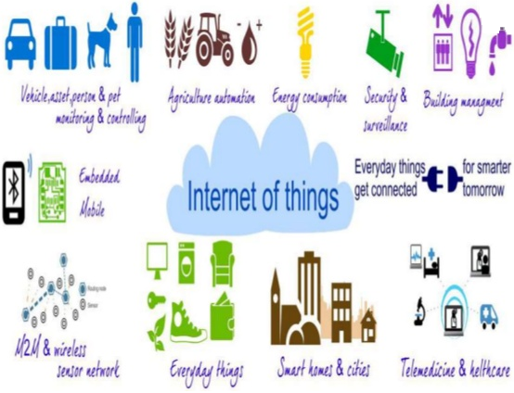
Applications of IoT
According to some researches there will be nearly 26 billion devices on the Internet of Things by 2020
Media
Environmental monitoring
Infrastructure management
Manufacturing
Energy management
Medical and healthcare systems
Building and home automation
Transportation
Large scale deployments
Etc.

Slide 7
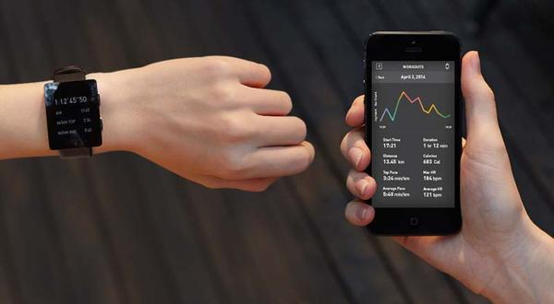
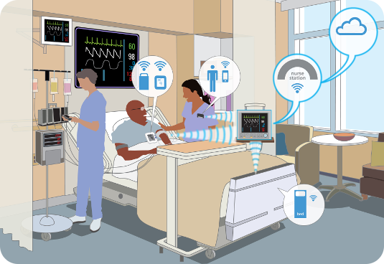
Applications

Slide 8

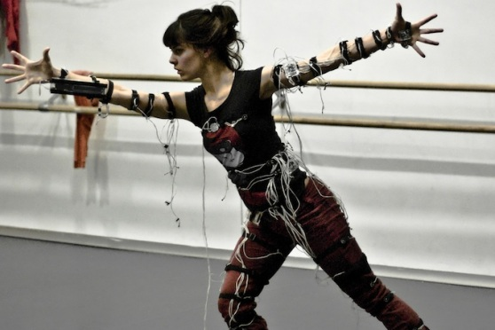

Technology
Identification
Unique ID (IP address)
Optical ID (bar-code, qr-code, etc)
RFID
etc
Sensing
Light, gas, noise, moisture sensors and etc.
Intellectual counters
Complex measuring circuitry
Communication
Wired (ethernet, SPI, I2R)
Wireless (wifi, bluetooth, Zigbee,RF,NFC)

Slide 9
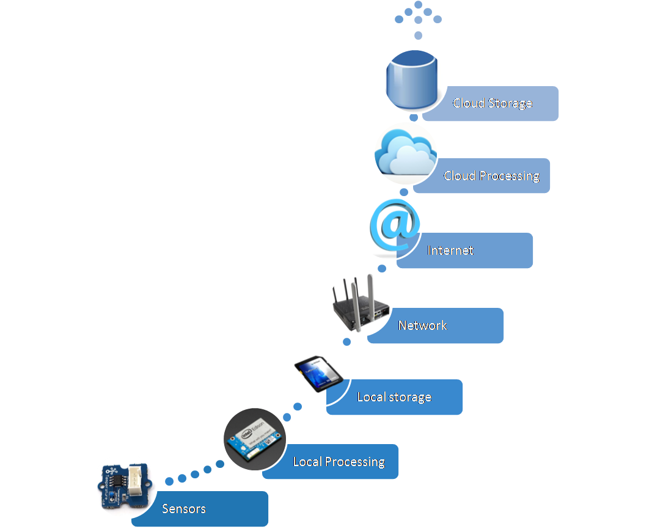
IoT Stack

Slide 10
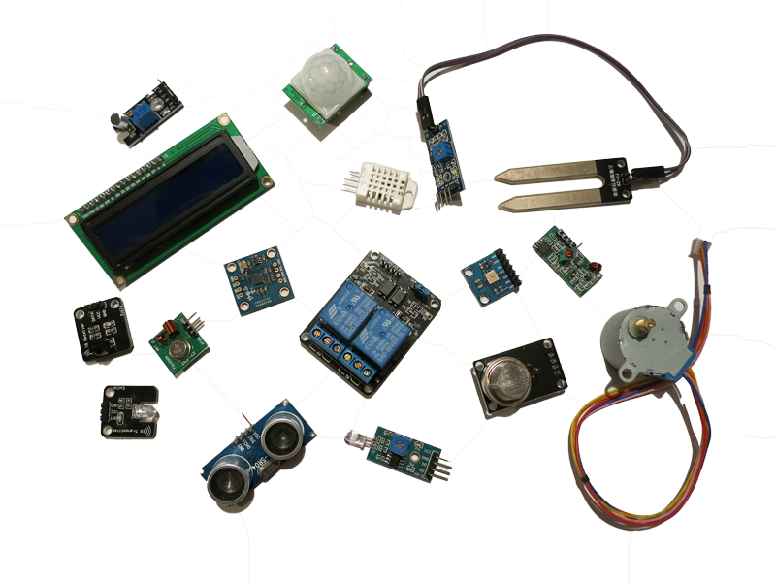
Sensors
Measure values
Sense data as analog
Send raw data
Transforms analog data to digital data
They merely do any processing
No not consume much power

Slide 11
Local processing and storage devices
Data is locally stored and processed
Ideally not sent forwards unless relevant.
Edge or fog computing

Slide 12
Network and Internet
IoT Gateways
Gathers some data
4 protocols used at this level:
CoAP
MQTT ( less secure and designed for machine to machine communication)
HTTP (web protocol)
XMPP which functions as a chat.

Slide 13
Cloud
Aggregate Data
Data is collected
Storage
Inferences
Makes predictions based on the stored information.
The cloud should not be loaded with irrelevant information

Slide 14
IoT DEVICES
SENSORS
MICRO
CONTROLLER
DAC
ADC
ACTUATORS
Receives data from the world
Causes events in the world

Slide 15
Measuring and Manipulating
IoT hardware has an interface to the real world
GPIO (General Purpose Input/Output) pins
Measure: read sensor value from input pin
Manipulate: write actuator value to output pin
Inputs and outputs can be digital or analog
Notes:
Messen und manipulieren
IoT Hardware hat immer eine Schnittstelle zur Realität
GPIO (General Purpose Input/Output) Pins
Messen: Sensor-Messwert vom Input-Pin lesen
Manipulieren: Aktuator Sollwert auf einen Output-Pin schreiben
Inputs und Outputs önnen digital oder analog sein

Slide 16
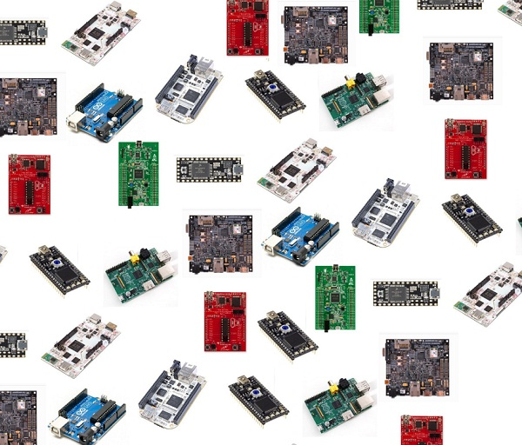
IoT Platforms
Arduino
Raspberry Pi
Intel Galileo
Adafruit
SparkFun
ARM mbed
Particle
Etc..

Slide 17
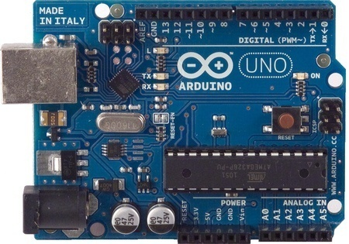
Arduino
Ideal open hardware platform for experimenting with the world of the Internet of Things.

Slide 18
What is Arduino?
A programmable micro controller for prototyping electromechanical devices.
Product from ITALY
The first Arduino was introduced in 2005.
Can connect Digital and Analog electronic signals.
Aim is to provide a low cost, easy way for novices and professionals to create devices that interact with their environment using sensors and actuators.
Common examples of such devices intended for beginner hobbyists include simple robots,thermostats, and motion detectors.
Arduino can interact with Buttons, LEDs, motors, speakers, GPS units, cameras, the Internet, and even your smart-phone or your TV!
It’s been used to make
Robots
Home automation gadgets for sensing and controlling lights, motors, locks and servos, sound and video, interactive objects like animated sculptures, toys, games and so on…
Automotive projects

Slide 19
Why use Arduino?
Inexpensive
Multiplatform environment (Cross Platform)- it can run on Windows, Macintosh, and Linux.
Based on the Processing programming IDE, an easy-to-use development environment used by artists and designers.
Program it via a USB cable, not a serial port - useful, because many modern computers don’t have serial ports.
Open source hardware and software—make your own, without paying anything to the makers of Arduino.
There is an active community of users, so there are plenty of people to help.

Slide 20
Types of Arduinos
Many different versions
Number of input/output channels
Form factor
Processor
UNO- great choice for your first Arduino
Mega-The Arduino Mega is like the UNO’s big brother. It has lots
(54!) of digital input/output pins (14 can be used as PWM
outputs),
Leonardo - with built-in USB
Yun - combination of a classic Arduino Leonardo with a Wifi
system-on-a-chip running Linino
LilyPad - for wearable and e-textile applications
Due
Micro
Esplora

Slide 21
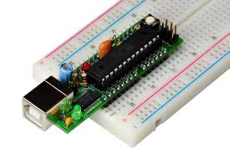
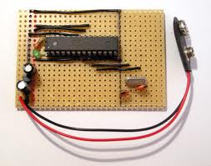

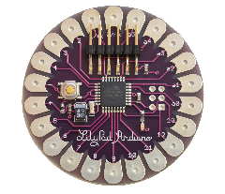
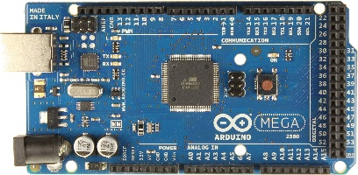
Types of Arduinos
Boarduino Kit
DIY Arduino
Arduino Uno
Arduino LilyPad
Arduino Mega 2560

Slide 22
Shield Vs Module
Shield
Shields are circuit boards that plug into the top of an Arduino.
They extend the capabilities of an Arduino.
Examples: Ethernet, GPS, Motor
Module
A module is something that you can connect( interface) with the arduino using standard jumper cables .

Slide 23
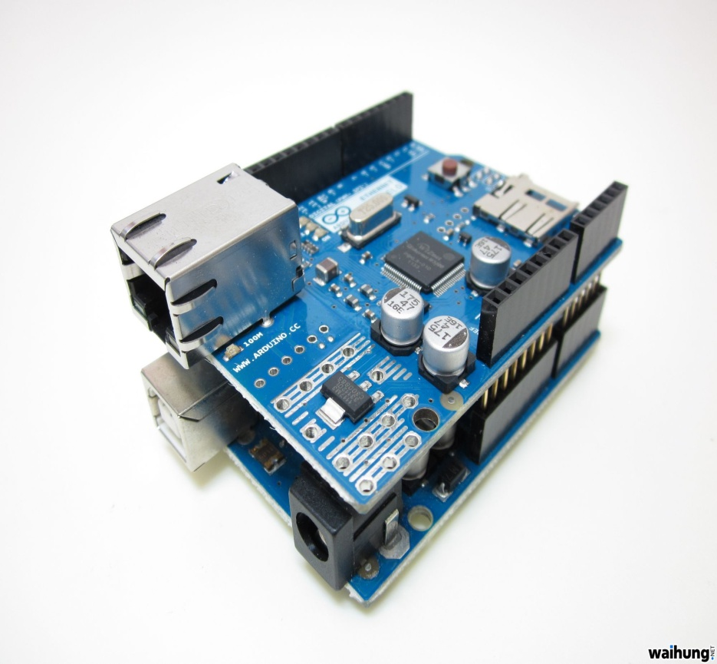
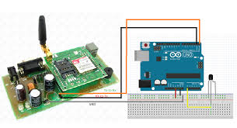
Example for Shield and Module
Shield
Module

Slide 24
Sample Specs: Arduino Uno
Microcontoller ATmega 328
Operating Voltage 5V
Input Voltage (recommended) 7-12V
Input Voltage (limits) 6-20V
Digital I/O Pins 14 (of which 6 provide PWM output)
Analog Input Pins 6
Flash Memory 32 KB (of which 0.5 KB used by bootloader)
SRAM 2 KB (ATmega328)
EEPROM 1 KB (ATmega328)
Clock Speed 16 MHz

Slide 25
Arduino Components
Two major parts
1. Arduino board - piece of hardware
2. Arduino IDE - piece of software you run on your computer. You use the IDE to create a sketch (a little computer program) that you upload to the Arduino board.
The sketch tells the board what to do.

Slide 26
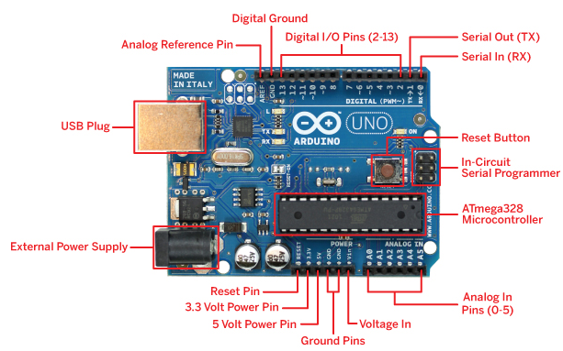
Arduino Components - Board

Slide 27
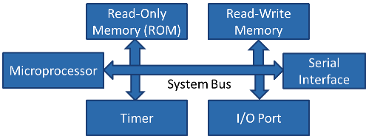
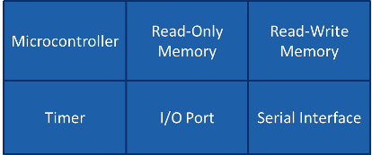
Microprocessor | Micro Controller
Microprocessor is heart of Computer system. | Micro Controller is a heart of embedded system.
It is just a processor. Memory and I/O components have to be connected externally | Micro controller has external processor along with internal memory and i/O components
Since memory and I/O has to be connected externally, the circuit becomes large. | Since memory and I/O are present internally, the circuit is small.
Cannot be used in compact systems and hence inefficient | Can be used in compact systems and hence it is an efficient technique
Cost of the entire system increases | Cost of the entire system is low
Due to external components, the entire power consumption is high. Hence it is not suitable to used with devices running on stored power like batteries. | Since external components are low, total power consumption is less and can be used with devices running on stored power like batteries.
Most of the microprocessors do not have power saving features. | Most of the micro controllers have power saving modes like idle mode and power saving mode. This helps to reduce power consumption even further.
Since memory and I/O components are all external, each instruction will need external operation, hence it is relatively slower. | Since components are internal, most of the operations are internal instruction, hence speed is fast.
Microprocessor have less number of registers, hence more operations are memory based. | Micro controller have more number of registers, hence the programs are easier to write.
Microprocessors are based on von Neumann model/architecture where program and data are stored in same memory module | Micro controllers are based on Harvard architecture where program memory and Data memory are separate
Mainly used in personal computers | Used mainly in washing machine, MP3 players

Slide 28
What is the difference between a ‘Digital Input’ and an ‘Analog Input’?
Very simply... digital signals are either ON (binary 1) or OFF (binary 0).
Digital input signals are used to represent items that only have two (2) states, such as... ON or OFF states ALARM or NORMAL conditions.
Similarly, Digital output signals are used to control items that again only have two states, such as.. START or STOP a device turn an indicator ON or OFF.
Analog signals are variable, they have multiple states. Analog input signals can represent such items as temperature or level or rate of flow.
Analog output signals are also variable and can be used for such things as opening a valve to a desired position.
So, use digitals for 2 state devices and analogs for multiple state devices.

Slide 29
IO Pins
14 Digital IO pins (pins 0–13)- These can be inputs or outputs, which is specified by the sketch you create in the IDE.
6 Analog In pins (pins 0–5) - These dedicated analogue input pins take analogue values (i.e., voltage readings from a sensor) and convert them into a number between 0 and 1023.
6 Analog Out pins (pins 3, 5, 6, 9, 10, and 11) - These are actually six of the digital pins that can be reprogrammed for analogue output using the sketch you create in the IDE.

Slide 30
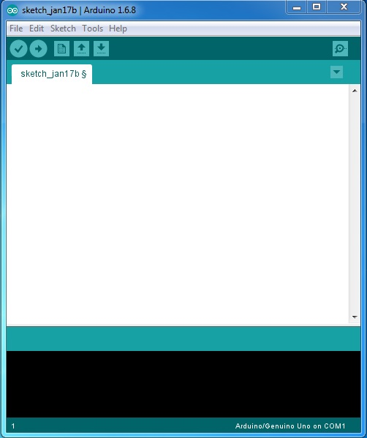
Arduino IDE

Slide 31
Arduino IDE
Arduino Code
Program Notification Area
Status Bar

Slide 32
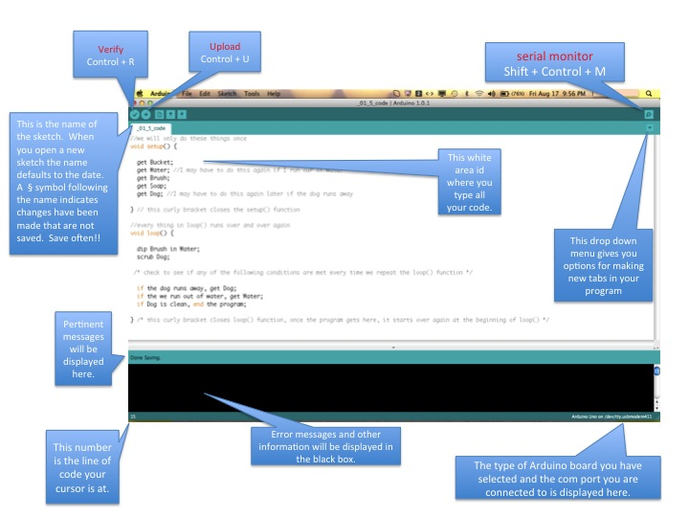
Arduino IDE

Slide 33
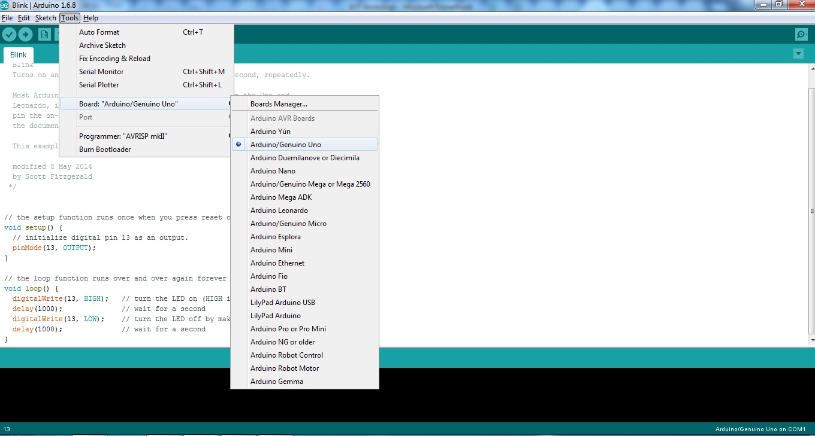
Arduino IDE- Configuration

Slide 34
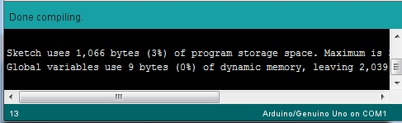
Verify/Compile
Once it compiles, you must see the following messages in the Status bar and the Program notification Area

Slide 35
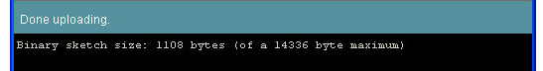
Upload
Once it upload, you must see the following messages in the Status bar and the Program notification Area

Slide 36
Arduino Program Development
Based on C++ - Arduino C is a greatly simplified version of C++.
A handful of new commands.
Programs are called 'sketches‘ with .ino extension.
Sketches need two functions:
void setup( )
void loop( )
setup( ) runs first and once.
loop( ) runs over and over, until power is lost or a new sketch is loaded.

Slide 37
Arduino Bootloader
Like OS – Starts Execution
Void main()
{
setup();
while(1)
loop();
}

Slide 38
Arduino C Specific Functions
pinMode(pin, mode) -Designates the specified pin for input or output
digitalWrite(pin, value)- Sends a voltage level to the designated pin
digitalRead(pin) -Reads the current voltage level from the designated pin
analog versions of above
analogRead's range is 0 to 1023

Slide 39
Serial Commands
Serial.begin()
- e.g., Serial.begin(9600)
Serial.print() or Serial.println()
- e.g., Serial.print(value)
Serial.read()
Serial.available()
Serial.write()
Serial.parseInt()

Slide 40
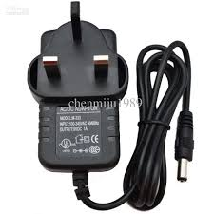
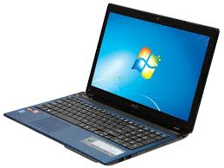
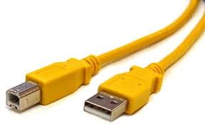
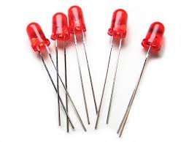
What Do We Need?

Slide 41
LED
The LED (Light emitting diode) is a simple, digital actuator.
LED light bulbs are more efficient than fluorescent or incandescent bulbs.
LEDs are a semiconductor device which converts electricity into light by using the movement of electrons.
LEDs have a short leg (-) and a long leg (+)
To prevent damage, LEDs are used together with a 1KΩ resistor (or anything from 300Ω to 2KΩ)
+
-
+
-
Anode
Cathode

Slide 42
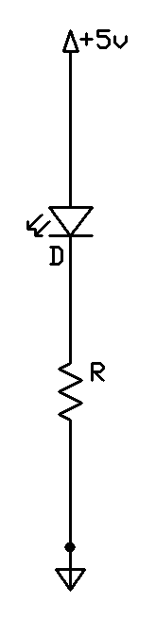
Basic LED Circuit
Connect the positive (+) lead of a power source to the long leg of an LED.
Connect other leg of the LED to a resistor.
High resistance means a darker light.
Low resistance means brighter light.
No resistance means a burned out LED.
Connect other leg of the resistor to the negative lead of the power source.

Slide 43
Advantages of LED
LEDs don’t contain mercury or other toxins and don’t emit UV light, so they don't attract bugs.
They also are resistant to shocks and vibrations.
Small LED bulbs generate very little heat, so they are cool to touch.
LED bulbs don't generate radio frequency waves, and therefore don't interfere with TV or radio broadcasts.

Slide 44
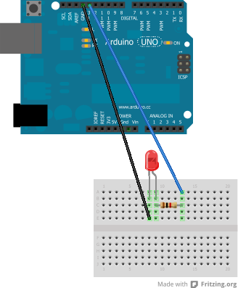
LED- connection with Arduino
Note: the additional 1K Ω resistor should be used to prevent damage to the pins / LED if it’s reversed
The long leg of the LED is connected to pin 13, the short leg to ground (GND)
+
The Ethernet Shield is not needed here
Notes:
Verdrahten einer LED mit Arduino
Bemerkung: der zusätzliche 1K Ohm Widerstand sollte benutzt werden um Schäden an Pins / LED zu vermeiden, falls sie verkehrt eingesteckt wird.
Das längere Bein der LED ist mit Pin 13 verbunden, das kürzere mit Erde, oder Ground (GND)
Der Ethernet shield wird hier nicht benötigt

Slide 45
Single LED- Blink Code
int ledpin=13;
void setup() {
pinMode(ledpin, OUTPUT); // initialize digital pin 13 as an output.
}
// the loop function runs over and over again forever
void loop() {
digitalWrite(ledpin, HIGH); // turn the LED on (HIGH is the voltage level)
delay(1000); // wait for a second
digitalWrite(ledpin, LOW); // turn the LED off by making the voltage LOW
delay(1000); // wait for a second
}

Slide 46
Like to give a try developing traffic light Signaling ????

Slide 47
Four LED- Blink Code
void setup( ) {
pinMode(1, OUTPUT);
pinMode(3, OUTPUT);
pinMode(5, OUTPUT);
pinMode(7, OUTPUT);
}
void loop( )
{
digitalWrite(1, HIGH);
delay (200);
digitalWrite(1, LOW);
digitalWrite(3, HIGH);
delay (200);
digitalWrite(3, LOW);
digitalWrite(5, HIGH);
delay (200);
digitalWrite(5, LOW);
digitalWrite(7, HIGH);
delay (200);
digitalWrite(7, LOW);
}

Slide 48
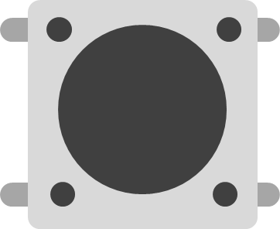
The Switch
A switch is a simple, digital sensor
Switches come in different forms, but all of them in some way open or close a gap in a wire
The pushbutton switch has four legs for easier mounting, but only two of them are needed
Notes:
Der Schalter
Ein Schalter ist ein einfacher, digitaler Sensor
Schalter gibt es in verschiedenen Formen, aber alle davon öffnen und schliessen eine Lücke in einem Kabel.
Der Druckknopf hat vier Beine um die Montage zu vereinfachen, aber nur zwei davon werden benötigt
Bemerkung: Schalter kann man auch einfach selber bauen, siehe z.B. diesen Link.

Slide 49
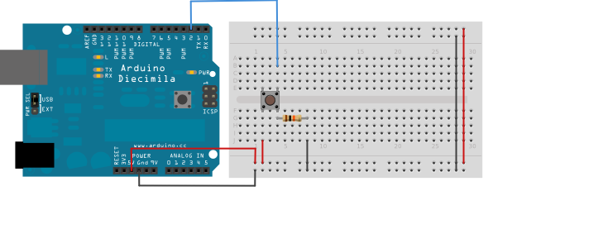
Push Button-Connection with Arduino

Slide 50
Push Button- Digital Read Serial
/* Reads a digital input on pin 2, prints the result to the serial monitor */
int pushButton = 2; void setup()
{ Serial.begin(9600); pinMode(pushButton, INPUT); } void loop() { int buttonState = digitalRead(pushButton); Serial.println(buttonState); delay(1); }

Slide 51
LED With Push Button
// digital pin 2 has a pushbutton attached to it.
int pushButton = 2;
void setup() {
Serial.begin(9600);
pinMode(pushButton, INPUT);
}
void loop() {
int buttonState = digitalRead(pushButton);
if (buttonState==1)
//Serial.println("pressed");
digitalWrite(13,HIGH);
else
digitalWrite(13,LOW) ;
//Serial.println("open");
delay(1000); // delay in between reads for stability
}

Slide 52
LED-Fade (Analog Write)
int led = 9; // the PWM pin the LED is attached to
int brightness = 0; // how bright the LED is
int fadeAmount = 5; // how many points to fade the LED by
void setup()
{
pinMode(led, OUTPUT);
}
void loop()
{
analogWrite(led, brightness);
brightness = brightness + fadeAmount;
if (brightness == 0 || brightness == 255)
{
fadeAmount = -fadeAmount ;
}
delay(30);
}

Slide 53
Sensors
Potentiometer
Temperature
Ultrasonic
PIR
LDR
Flex
Soil Moisture
Humidity
Bluetooth
GSM
GPS

Slide 54
Working with Sensors

Slide 55
Potentiometer-AnalogReadSerial
A potentiometer, informally a pot, is a three-terminal resistor with a sliding or rotating contact that forms an adjustable voltage divider.
If only two terminals are used, one end and the wiper, it acts as a variable resistor or rheostat.

Slide 56
Potentiometer- Applications
Audio control
to control audio equipment, changing loudness, frequency attenuation, and other characteristics of audio signals
Television
to control picture brightness, contrast, and color response.
Motion control
Transducers
Computation

Slide 57
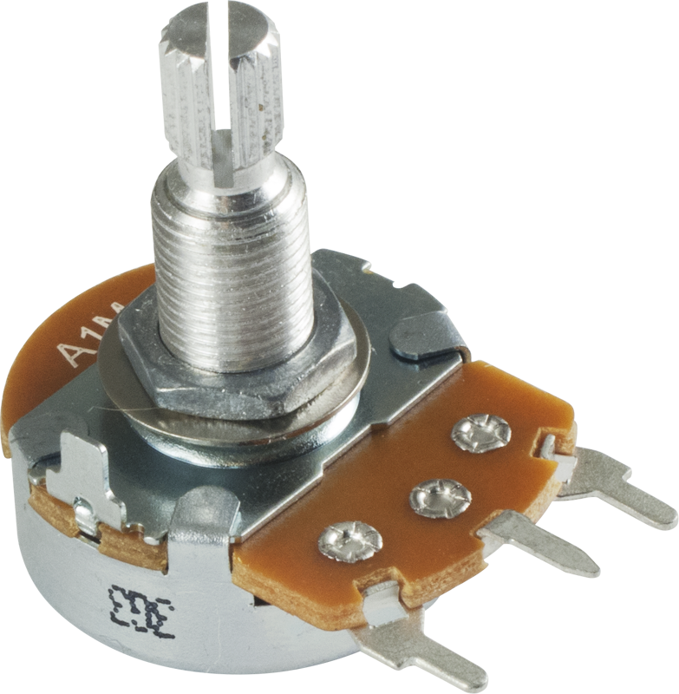
How a potentiometer looks like?

Slide 58
Analog Input- Application
The variable resistor can be replaced with a sensor.
For example, a photo resistor.
Depending upon the light level at the photo resistor:
Turn on a light
Increase or decrease the brightness of an LED (or an LED array)
Most sensors are simply variable resistors, but vary their resistance based on some physical characteristic.

Slide 59
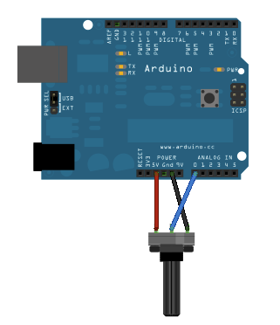
Potentiometer- Connections

Slide 60
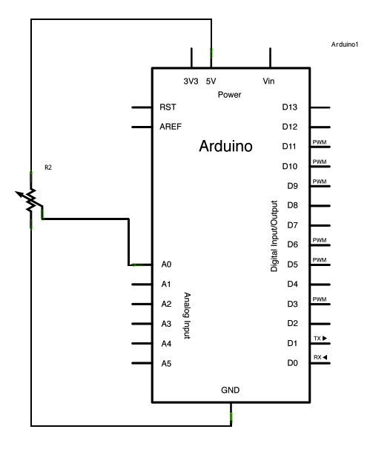
Potentiometer-AnalogReadSerial

Slide 61
Potentiometer-Code
void setup()
{ Serial.begin(9600); } void loop() { int sensorValue = analogRead(A0); Serial.println(sensorValue); delay(1); // delay in between reads for stability }

Slide 62
Temperature Sensor
Gathers data concerning the temperature from a source
Converts it into a form that can be displayed and understood by a user or another device.
A temperature sensor is often a resistance temperature detector or thermocouple that measures temperature through an electrical signal.
The temperature sensor can only be connected to a circuit in one direction

Slide 63
Temperature Sensor- Applications
Measurement systems.
Aircrafts use temperature sensors to determine if there are any atmospheric icing conditions along their flight path and to initialize weather forecast models.
To help determine if icing conditions exist.
Refrigerators
Freezers
Air conditioners
Heaters
Water heaters.

Slide 64
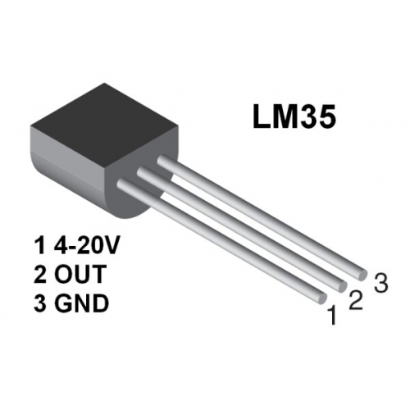
How a temperature sensor look like?

Slide 65
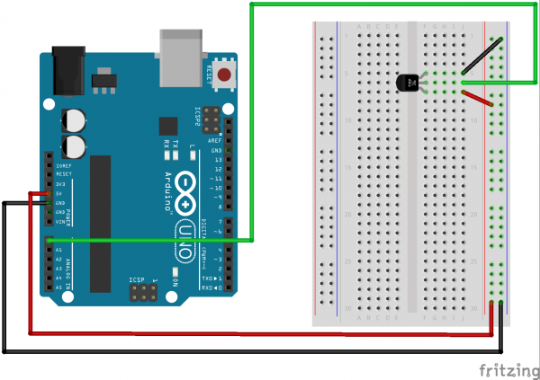
Temperature Sensor- Connetcions

Slide 66
Temperature Sensor- Code
float tempC; int reading; int tempPin =A0; void setup() { analogReference(INTERNAL); Serial.begin(9600); } void loop() { reading = analogRead(tempPin); tempC = reading / 9.31; Serial.println(tempC); delay(1000); }

Slide 67
Temperature Sensor- Code
int val; int tempPin = 1; void setup() { Serial.begin(9600); } void loop() { val = analogRead(tempPin); float mv = ( val/1024.0)*5000; float cel = mv/10; float farh = (cel*9)/5 + 32; Serial.print("TEMPRATURE = "); Serial.print(cel); Serial.print("*C"); Serial.println(); delay(1000); /* To get temperature in farenhite */ Serial.print("TEMPRATURE = "); Serial.print(farh); Serial.print("*F"); Serial.println(); }

Slide 68
Ultrasonic Sensor
Object detection
Level measurement with millimetre precision
Extremely robust

Slide 69
Ultrasonic Sensors- Applications
Mechanical engineering/machine tool
Food and beverage
Woodworking and furniture
Building materials
Agriculture
Construction
Pulp and paper
Material handling
Level measurement

Slide 70
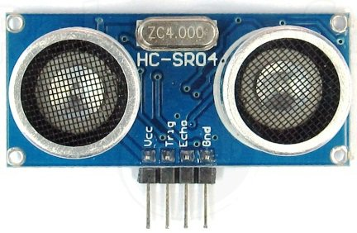
How an ultrasonic sensor look like?

Slide 71
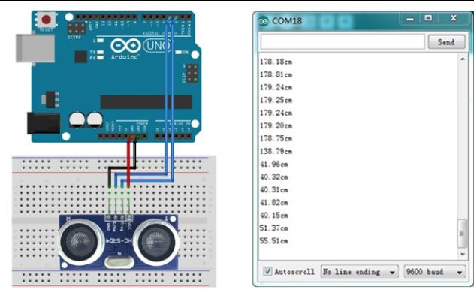
Ultrasonic Sensor- Connections

Slide 72
Ultrasonic Sensor- Code
const int trigpin=9;
const int echopin=10;
long duration;
int distance;
void setup() {
pinMode(trigpin,OUTPUT);
pinMode(echopin,INPUT);
Serial.begin(9600);
}
void loop() {
digitalWrite(trigpin,LOW);
delayMicroseconds(2);
digitalWrite(trigpin,HIGH);
delayMicroseconds(10);
digitalWrite(trigpin,LOW);
duration=pulseIn(echopin,HIGH);
distance = duration * 0.034 / 2;
Serial.print("Distance : ");
Serial.println(distance);
}

Slide 73
PIR Sensor
Passive Infra Red or Pyroelectric or IR motion sensors
Sense Motion
Measures infrared (IR) light radiating from objects in its field of view

Slide 74
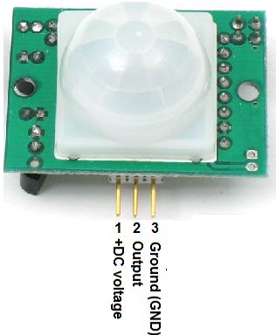
How a PIR Sensor look like?

Slide 75
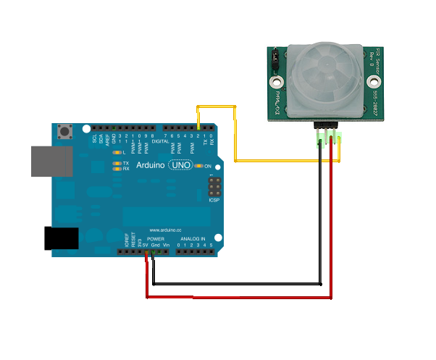
PIR Sensor- Connections

Slide 76
PIR Sensor- Code
//Simple PIR sketch:
setup()
{
pinMode(13,OUTPUT);
pinMode(2,INPUT);
}
loop()
{
digitalWrite(13,digitalRead(2));
}

Slide 77
PIR Sensor- Code
int ledpin = 13;
int pirpin =A0;
int val=0;
void setup()
{
pinMode(ledpin,OUTPUT);
pinMode(pirpin,INPUT);
Serial.begin(9600);
}
void loop()
{
val=analogRead(pirpin);
Serial.println(val);
if(val>=5)
digitalWrite(ledpin,HIGH);
else
digitalWrite(ledpin,LOW);
}

Slide 78
GSM
Booting the GSM Module!
1. Insert the SIM card to GSM module and lock it.
2. Connect the adapter to GSM module and turn it ON!
3. Now wait for some time (say 1 minute) and see the blinking rate of ‘status LED’ or ‘network LED’ (GSM module will take some time to establish connection with mobile network)
4. Once the connection is established successfully, the status/network LED will blink continuously every 3 seconds. You may try making a call to the mobile number of the sim card inside GSM module. If you hear a ring back, the gsm module has successfully established network connection.

Slide 79
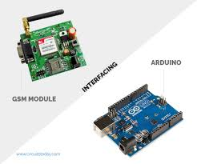
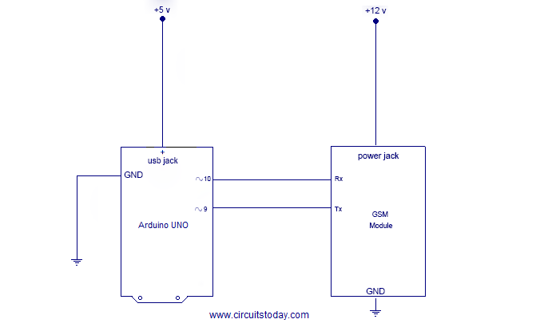
GSM

Slide 80
GSM
#include <SoftwareSerial.h>
SoftwareSerial mySerial(9, 10);
void setup()
{
mySerial.begin(9600); // Setting the baud rate of GSM Module
Serial.begin(9600); // Setting the baud rate of Serial Monitor (Arduino)
delay(100);
}
void loop()
{
if (Serial.available()>0)
switch(Serial.read())
{
case 's':
SendMessage(); break;
case 'r':
RecieveMessage(); break;
}
if (mySerial.available()>0)
Serial.write(mySerial.read());
}

Slide 81
GSM
void SendMessage()
{
mySerial.println("AT+CMGF=1"); //Sets the GSM Module in Text Mode
delay(1000); // Delay of 1000 milli seconds or 1 second
mySerial.println("AT+CMGS=\"+91XXXXXXXX\"\r"); // Replace x with mobile number
delay(1000);
mySerial.println("I am SMS from GSM Module");// The SMS text you want to send
delay(100);
mySerial.println((char)26);// ASCII code of CTRL+Z
delay(1000);
}
void RecieveMessage()
{
mySerial.println("AT+CNMI=2,2,0,0,0"); // AT Command to recieve a live SMS
delay(1000);
}

Slide 82
REED Switch
The reed switch is an electrical switch operated by an applied magnetic field.
It consists of a pair of contacts on ferrous metal reeds in a hermetically sealed glass envelope.
The contacts may be normally open, closing when a magnetic field is present, or normally closed and opening when a magnetic field is applied.

Slide 83
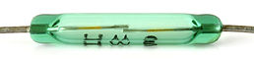
How a Reed Switch look like?

Slide 84
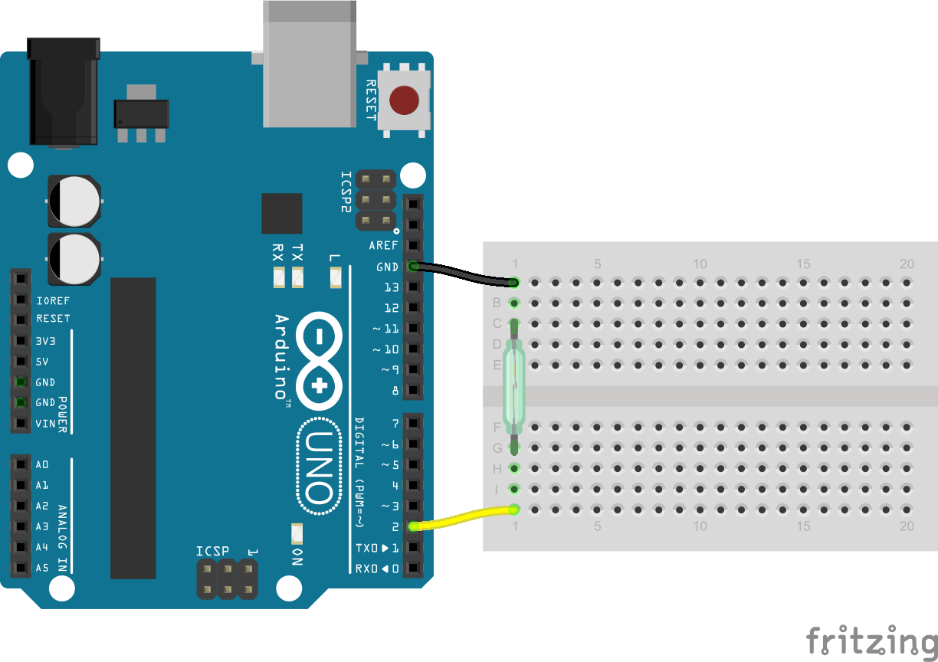
Reed Switch- Connections

Slide 85
REED Switch- Code
const int pinSwitch = 12; //Pin Reed
const int pinLed = 9; //Pin LED
int StatoSwitch = 0;
void setup() {
pinMode(pinLed, OUTPUT); //Imposto i PIN
pinMode(pinSwitch, INPUT);
}
void loop() {
StatoSwitch = digitalRead(pinSwitch); //Leggo il valore del Reed
if (StatoSwitch == HIGH) {
digitalWrite(pinLed, HIGH);
}
else {
digitalWrite(pinLed, LOW);
}
}

Slide 86
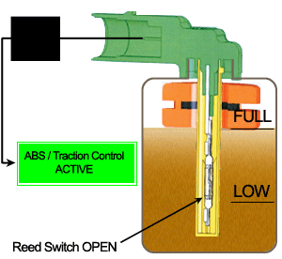
REED Application

Slide 87
Light Dependent Resistor (LDR)
A Light Dependent Resistor (LDR) or a photo resistor is a device whose resistivity is a function of the incident electromagnetic radiation.
Other names: photo conductors, photo conductive cells or simply photocells

Slide 88
Applications of LDR
They are used when there is a need to detect absences or presences of light like in a camera light meter.
Street lamps
alarm clock
Burglar alarm circuits
Light intensity meters,
Counting the packages moving on a conveyor belt, etc.

Slide 89
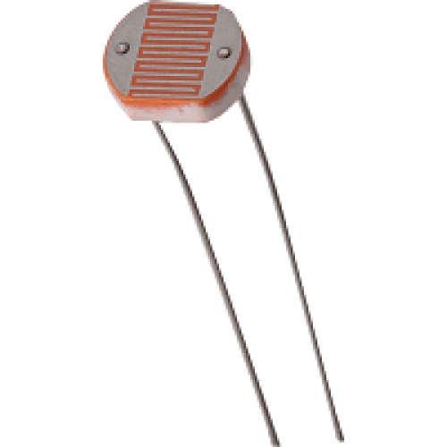
How an LDR looks like?

Slide 90
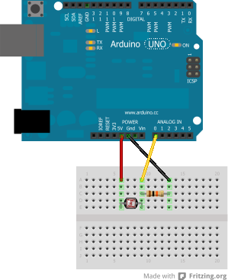
LDR – Connection with Arduino
Note: this setup is a voltage-divider, as the 5V total voltage is divided between LDR and resistor to keep 0V < A0 < 2.5V
Photoresistor (LDR)
10K Ω resistor
5V
GND
A0
Notes:
LDR verkabeln mit Arduino
Bemerkung: diese Schaltung heisst auch Spannungsteiler, weil die 5V Spannung zwischen dem LDR und einem Widerstanf aufgeteilt werden, damit A0 zwischen 0 und 2.5V bleibt

Slide 91
LDR- Code
int sensorPin = A0; // select the input pin for ldr
int sensorValue = 0; // variable to store the value coming from the sensor
void setup() {
Serial.begin(9600); //sets serial port for communication
}
void loop() {
sensorValue = analogRead(sensorPin); // read the value from the sensor
Serial.println(sensorValue); //prints the values coming from the sensor on the screen
delay(1000);
}

Slide 92
Flex Sensor
Flex Sensor’ or ‘Bend Sensor’
Changes its resistance depending on the amount of bend on the sensor.
They convert the change in bend into electrical resistance – the more the bend, the more the resistance value.

Slide 93
Flex Sensors- Applications
Automotive controls
Medical Devices
Fitness Products
Virtual Reality gaming consoles
Animatronics, Robotics
etc. .

Slide 94
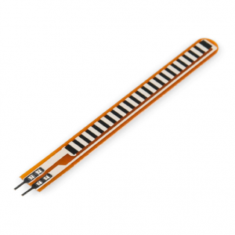
How Flex Sensor looks like?

Slide 95
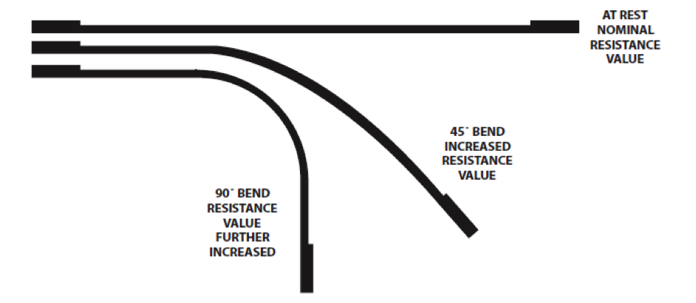
Understanding Flex sensor

Slide 96
Flex Sensor- Code
constintledPin = 3; //pin 3 has PWM funtion
constintflexPin = A0; //pin A0 to read analog input
int value; //save analog value
void setup(){
pinMode(ledPin, OUTPUT); //Set pin 3 as 'output'
Serial.begin(9600); //Begin serial communication
}
void loop(){
value = analogRead(flexPin); //Read and save analog value from potentiometer
Serial.println(value); //Print value
value = map(value, 700, 900, 0, 255);//Map value 0-1023 to 0-255 (PWM)
analogWrite(ledPin, value); //Send PWM value to led
delay(100); //Small delay
}

Slide 97
Humidity Sensor
Humidity sensor or dew sensor or hygrometer
Senses, measures and reports the relative humidity in the air.
It therefore measures both moisture and air temperature.
Relative humidity is the ratio of actual moisture in the air to the highest amount of moisture that can be held at that air temperature.

Slide 98
Humidity Sensors- Applications
Used as a monitoring and preventive measure in homes for people with illnesses that are affected by humidity.
Found as part of home heating, ventilating, and air conditioning systems (HVAC systems).
Found in offices, cars, humidors, museums, industrial spaces and greenhouses
Used in meteorology stations to report and predict weather.
Dew sensors are used in the coating industry because the application of paint and other coatings may be extremely sensitive to dew point

Slide 99
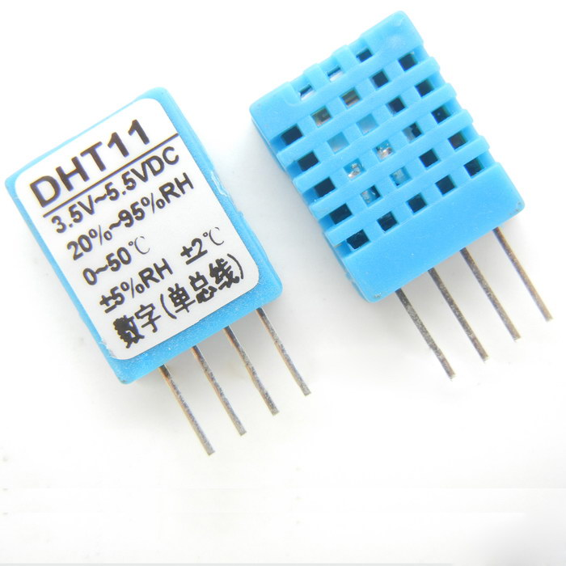
How Humidity Sensors looks like?

Slide 100
Humidity Sensor- Code
#include<dht.h>
dht DHT;
// if you require to change the pin number, Edit the pin with your arduino pin.
#define DHT11_PIN 3
void setup() {
Serial.begin(9600);
Serial.println("welcome to Humidity and temperature Detector"); }
void loop() { // READ DATA
intchk = DHT.read11(DHT11_PIN);
Serial.print(" Humidity: " );
Serial.println(DHT.humidity, 1);
Serial.print(" Temparature: ");
Serial.println(DHT.temperature, 1);
delay(2000);
}

Slide 101
Soil Moisture
Measures the volumetric water content in soil.
Applications:
Agriculture
Landscape irrigation
Research
Simple sensors for gardeners

Slide 102
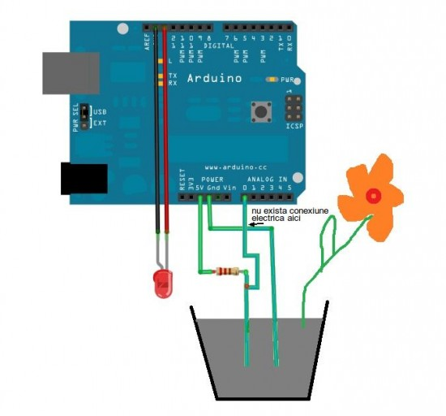
Understanding Soil Moisture

Slide 103

How does a soil moisture sensor looks like?

Slide 104

Connections

Slide 105
Soil Moisture- Code
void setup(){
Serial.begin(9600);
}
void loop(){
intsoil_moisture=analogRead(A0); // read from analog pin A3
Serial.print(soil_moisture);
if(soil_moisture>750) {
Serial.println("Dry soil");
}
if((soil_moisture>300)&&(soil_moisture<700)) {
Serial.println("Humid soil");
}
if((soil_moisture>0)&&(soil_moisture<300)){
Serial.println("water");
}
delay(2000);
}

Slide 106
Accelerometer
Measures proper acceleration, associated with the weight of a test mass.
An accelerometer behaves like a damped mass on a spring.
When an accelerometer experiences acceleration, the mass is displaced to the point of at which the spring can accelerate the mass at the same rate as the casing.
The displacement is then measured in order to give the acceleration.

Slide 107
Accelerometer - Applications
Measure vehicle acceleration
They can also measure seismic activity, inclination, dynamic distance, speed and machine vibration.
Accelerometers are also increasingly found in biological sciences and allow the discrimination of behavioral patterns when animals are out of sight.
They can also be found in machinery health monitoring applications to report vibrations and their changes in time of shafts at the bearings of rotating equipment like fans, turbines, pumps, compressors, rollers and cooling towers.
Measure the vibration in
Vehicles
process control systems
Machines
Buildings and safety installations.

Slide 108

How does an accelerometer look like?

Slide 109

Connections

Slide 110
Accelerometer- Code
constint ap1 = A5; constint ap2 = A4; constint ap3 = A3;
int sv1 = 0; int ov1 = 0; int sv2 = 0;
int ov2= 0; int sv3 = 0; int ov3= 0;
void setup() { // initialize serial communications at 9600 bps:
Serial.begin(9600);
}
void loop() {
analogReference(EXTERNAL); //connect 3.3v to AREF
sv1 = analogRead(ap1); // read the analog in value:
ov1 = map(sv1, 0, 1023, 0, 255); // map it to the range of the analog out:
delay(2); // change the analog out value:
sv2 = analogRead(ap2);
ov2 = map(sv2, 0, 1023, 0, 255);
delay(2);
sv3 = analogRead(ap3);
ov3 = map(sv3, 0, 1023, 0, 255);
// print the results to the serial monitor:
Serial.print("Xsensor1 = " );
Serial.print(sv1);
Serial.print("\t output1 = ");
Serial.println(ov1);
Serial.print("Ysensor2 = " );
Serial.print(sv2);
Serial.print("\t output2 = ");
Serial.println(ov2);
Serial.print("Zsensor3 = " );
Serial.print(sv3);
Serial.print("\t output3 = ");
Serial.println(ov3);
delay(3000);
}

Slide 111

Bluetooth and its connection with Arduino
Bluetooth is an always-on, short-range radio hookup that resides on a microchip.

Slide 112
Servo Motor
A servomotor is a rotary actuator or linear actuator that allows for precise control of angular or linear position, velocity and acceleration.
Consists of a suitable motor coupled to a sensor for position feedback

Slide 113

How a Servo motor look like?

Slide 114
Servo Motor- Code
#include <Servo.h>
Servo myservo; // create servo object to control a servo
int potpin = 0; // analog pin used to connect the potentiometer
int val; // variable to read the value from the analog pin
void setup() {
myservo.attach(9); // attaches the servo on pin 9 to the servo object
}
void loop() {
val = analogRead(potpin); // reads the value of the potentiometer (value between 0 and 1023)
val = map(val, 0, 1023, 0, 180); // scale it to use it with the servo (value between 0 and 180)
myservo.write(val); // sets the servo position according to the scaled value
delay(15); // waits for the servo to get there
}

Slide 115

Bluetooth
Bluetooth is a wireless technology standard for exchanging data over short distances.

Slide 116

Bluetooth- Connection with Arduino

Slide 117
Bluetooth- Code
char data = 0; //Variable for storing received data
void setup() {
Serial.begin(9600); //Sets the data rate in bits per second (baud) for serial data transmission
pinMode(13, OUTPUT); //Sets digital pin 13 as output pin
}
void loop(){
if(Serial.available() > 0) {// Send data only when you receive data:
data = Serial.read(); //Read the incoming data and store it into variable data
Serial.print(data); //Print Value inside data in Serial monitor
Serial.print("\n"); //New line
if(data == '1') //Checks whether value of data is equal to 1
digitalWrite(13, HIGH); //If value is 1 then LED turns ON
else if(data == '0') //Checks whether value of data is equal to 0
digitalWrite(13, LOW); //If value is 0 then LED turns OFF
}
}

Slide 118
THANK YOU

